Slide 1
Introduction to quantum computing

Slide 2
What is quantum computing (qc)?
Quantum Computing is a new paradigm of algorithmic study which extends quantum mechanical phenomena to traditional or classical computing

Slide 3
What is quantum computer?
A Quantum Computer can be defined as a device that performs computation by leveraging specific properties described by Quantum Mechanics

Slide 4
What is quantum mechanics?
Quantum Mechanics is the field of Physics which tackles the physical properties of nature on an atomic scale
“Quantum” is a term that comes from the study of Quantum Mechanics.
In Human World, interactions and forces experienced are at macro-scale
Classical or Newtonian Mechanics
Thermodynamics and Statistical Mechanics
Electromagnetism and Photonics
Classical or Newtonian Mechanics
Modern Physics
Relativity & Quantum Mechanics

Slide 5
What is quantum mechanics?
In the infinitesimally small particles known as the subatomic scale, the macro-scale physics laws are not valid.
Rules in the macro-scale are flipped at the quantum scale and classical mechanics is insufficient to explain the behavior.
All quantities, in a Quantum System are restricted to their discrete values due to quantization, and objects, function as both particles and waves – Wave-Particle Duality.
Quantum Mechanics was born when Max Planck proposed a theory to explain black body radiation and later the theory connecting frequency and energy (photoelectric effect and general relativity) by Einstein

Slide 6
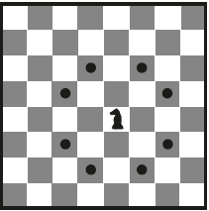
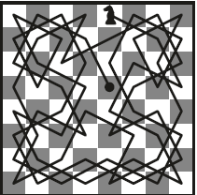
Why quantum computing?
Consider the popular Mathematical Problem “A Knight’s Tour – a game of Chess”
Requirements of the Knight’s Tour
The Knight can start at a random position on an eight-by-eight chessboard
The Knight can jump from one square to another, but must visit all of the squares on the board
The Knight can’t visit a square more than once
A Brute force Computer algorithm is not difficult to develop and code
A Possible Single Path

Slide 7
Why quantum computing? – knight’s square
On a 3 GHz Intel Core i7CPU, on an average a valid single path determination requires 10 minutes of computation time.
The computation time is dependent on the next square the Knight jumps.
If the next square has a large number of jump options, the computation time increases to find a valid path.
If the size of the dataset (8x8) is increased, the computation time increases exponentially.

Slide 8
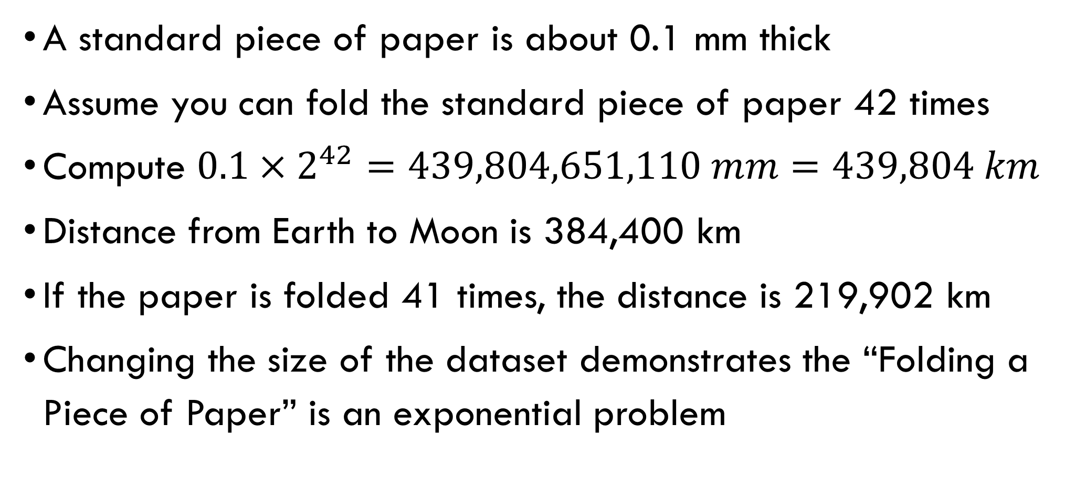
Why quantum computing? – Folding a piece of paper
A standard piece of paper is about 0.1 mm thick
Assume you can fold the standard piece of paper 42 times
Compute $0.1×2^{42}=439,804,651,110 mm=439,804 km$
Distance from Earth to Moon is 384,400 km
If the paper is folded 41 times, the distance is 219,902 km
Changing the size of the dataset demonstrates the “Folding a Piece of Paper” is an exponential problem

Slide 9
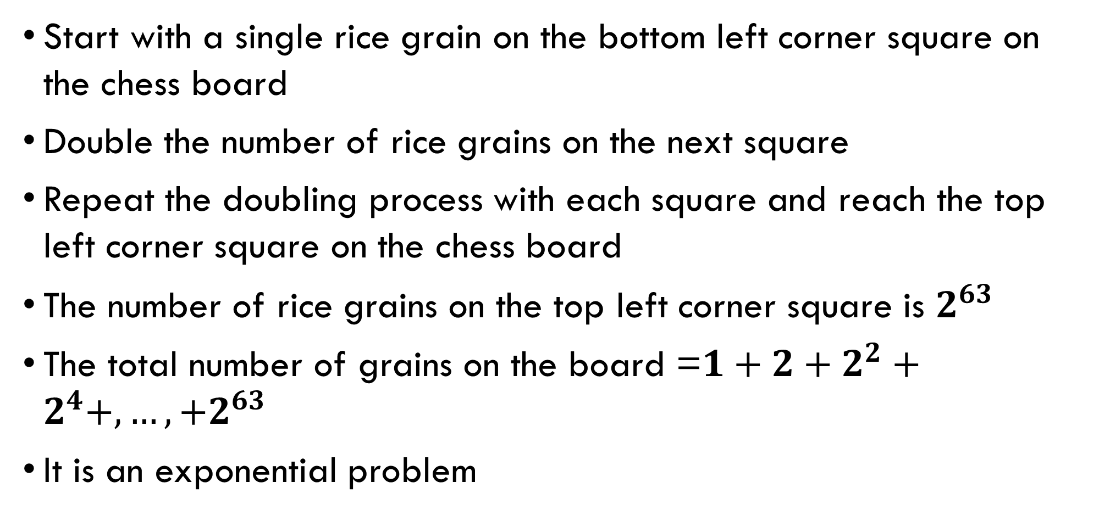
Why quantum computing? – rice grains on each square of the chess board
Start with a single rice grain on the bottom left corner square on the chess board
Double the number of rice grains on the next square
Repeat the doubling process with each square and reach the top left corner square on the chess board
The number of rice grains on the top left corner square is $2^{63}$
The total number of grains on the board =$1+2+2^{2}+2^{4}+, …, +2^{63}$
It is an exponential problem

Slide 10
Why quantum computing ?
Classical Computational Power does not scale exponentially
To double the Computational power of a CPU, the number of transistors has to be doubled approximately (Moore’s law)
Majority of the physical word problems are exponential in nature
Exponential problems are not practically solvable using current Classical Computers

Slide 11
Why quantum computing ? – algorithm complexity
Complexity of Algorithms are often expressed as Time Complexity
Generally, Algorithm complexity (time taken to complete) increases with increasing input data
Linear Complexity:
Let there be ‘n’ items of input data
Let each input data item require a fixed time ‘T’ to compute
If the total time of computation is proportional to n i.e., nT, the algorithm has linear time complexity

Slide 12
Why quantum computing ? – algorithm complexity
Majority of Algorithms experience the computational time growing nonlinearly with increase in ‘n’ the number of input data items
Total Computational Time α n² => Quadratic Complexity
Total Computational Time α n³
In general, Total Computational Time α n^{k} => Polynomial Complexity
If no known algorithm can solve a problem in polynomial time, the algorithm is said to take nonpolynomial time, and the problem is known as a NP hard problem
Algorithms are said to take exponential time or have exponential complexity if they require exponentially more steps when ‘n’ increases

Slide 13
Why quantum computing ?
Quantum Computers solve problems that are solved today by classical computers
Quantum Computers using the Quantum Mechanics principles will solve the same problem in a different approach resulting in dramatic performance improvement
Therefore, a Quantum Computers solves an Exponential time problem in Polynomial time

Slide 14
quantum computing – integer PRIME factorization
Integer prime factorization is a common operation in security encryption algorithms
Integer prime factorization is the process of computing smaller prime numbers, which when multiplied, yield the original number.
Example: Prime Factoring number 15 into smaller factors as 3 and 5.
For small integers, the factorization computational time is small

Slide 15
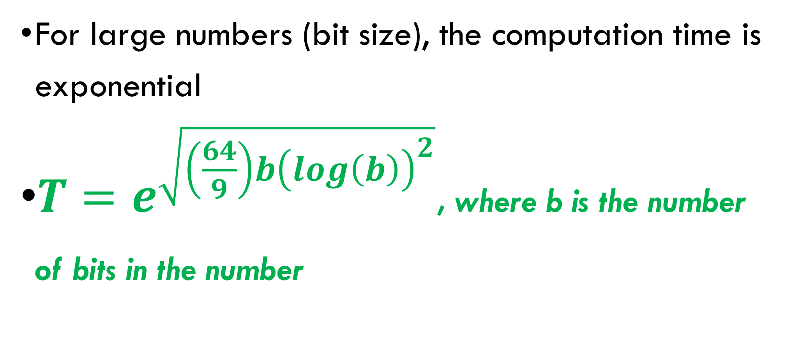
quantum computing – integer PRIME factorization
For large numbers (bit size), the computation time is exponential
$T=e^{\sqrt{\left(\frac{64}{9}\right)b{\left(log\left(b\right)\right)}^{2}}}$, where b is the number of bits in the number

Slide 16
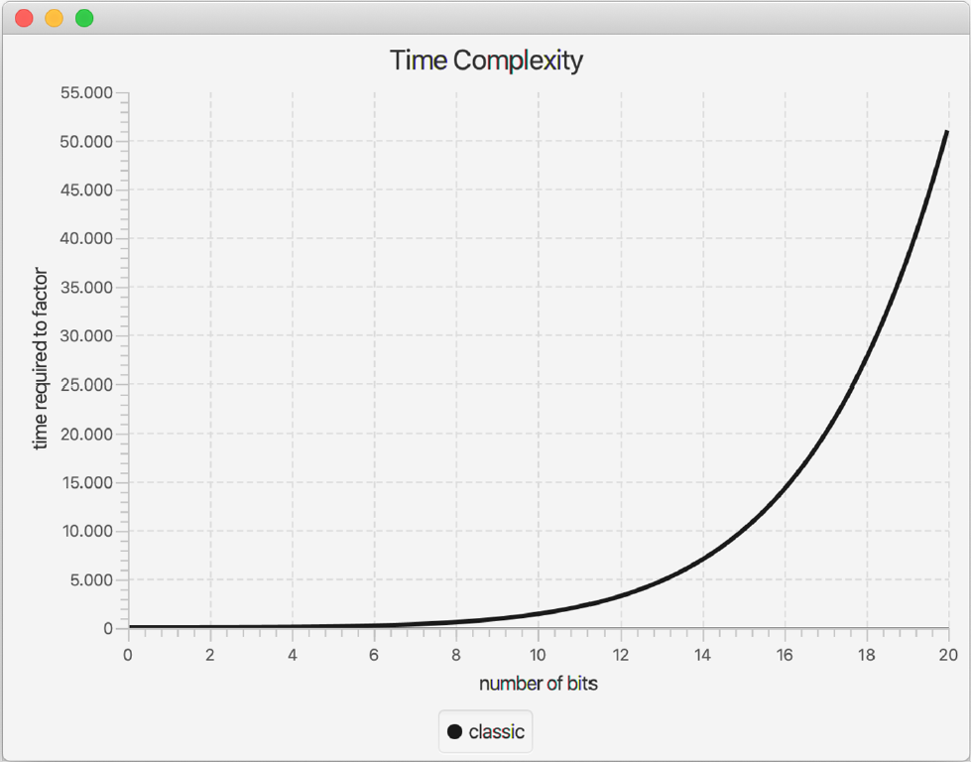
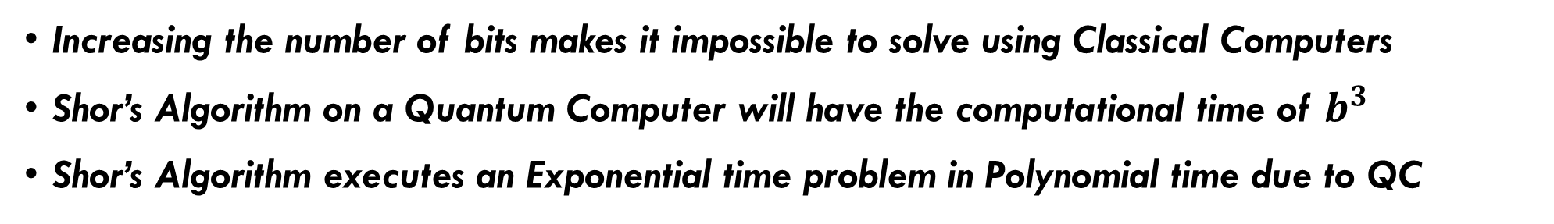
quantum computing – integer PRIME factorization
Increasing the number of bits makes it impossible to solve using Classical Computers
Shor’s Algorithm on a Quantum Computer will have the computational time of $b^{3}$
Shor’s Algorithm executes an Exponential time problem in Polynomial time due to QC

